Slide 1
Textile Quality Control with Image Processing Techniques
Done by:
Chaitali Thakkar (19BCE031)
Kaushha Trivedi (19BCE095)

Slide 2
Outline:
Motivation for the project
Objective of the project
Flow diagram
Description
Implementation
Results
Demo
Conclusion
References

Slide 3
Motivation behind the project
Objective of the project
The textile industry undergoes several steps of production before the final product reaches the market.
And with each step the quality of the product needs to be reassured.
As human visual inspection of the same could be very time consuming and could delay the production of the same.
Our objective is to use image processing techniques to identify the defects and assure the quality of the textile.

Slide 4
Flow Diagram for Textile Defect Detection using Fourier Transform
Processing technique used to improve contrast of an image
Observing the differences in images of each class type
Input Fabric Images from Dataset
Fabric Image
Image Acquisition
Histogram Equalization
Fourier Transform
Analysis
Transforms real-world optical image into an array of numerical data
Decomposes image into its sine and cosine components

Slide 5
Input Fabric Images from Dataset
A technique used for contrast adjustment using the image's histogram
Fabric Image
Image Acquisition
Histogram Equalization
Morphology
Analysis
Storing the real life image into an array
Image processing operations that process images based on shapes

Slide 6
Description
The dataset used is a public dataset, and has one set of 32x32 and another of 64x64 images; each set having a total of 48000 training and testing images.
The classes are - good, colour, cut, hole, metal contaminations & thread.
We, here use 2 methods - Fourier transform & Morphology
5 images from each class of the training dataset of 32x32 images has been taken and observations have been made accordingly.

Slide 7
Implementation : Fourier Transform

Slide 8
Fourier transform is a salient Image Processing tool that is used to convert images into frequency domain.
The spatial frequency directly relates with the brightness of the image. The magnitude of the sinusoid directly relates with the contrast.
The Fourier Transform is used in a wide range of applications, such as image analysis, image filtering, image reconstruction and image compression.
Fourier Transform

Slide 9
Implementation
The main approach that has been used for fabric defect detection is to perform fourier transformation on the given image and the threshold the image (or convert it to binary image).
After applying these operations on the image the defects in the fabric will be clearly visible in the histograms plotted
Here we have take 5 images from each category (good,colour,cut,holes and metallic contamination, thread),and and performed operation on them.

Slide 10
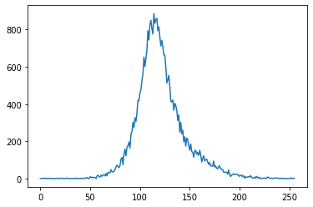
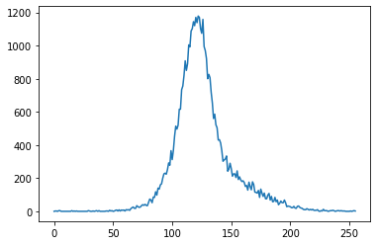

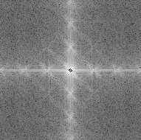
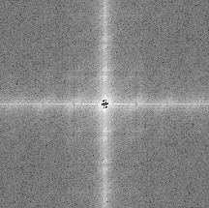
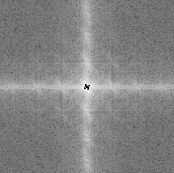
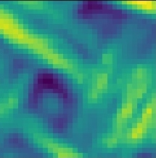
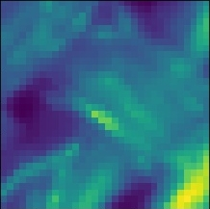
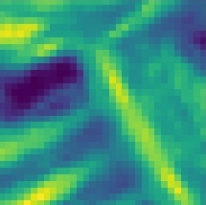
Class: Good Class: Colour Class: Cut

Slide 11
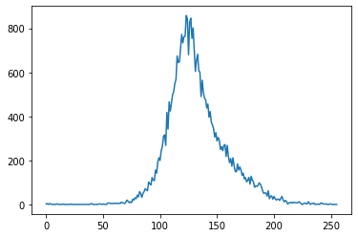
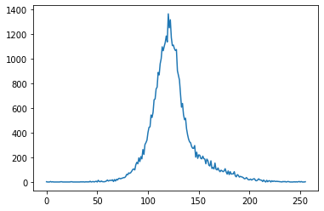
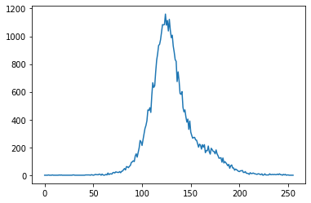
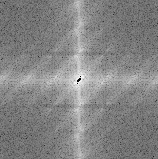
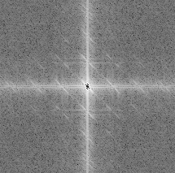
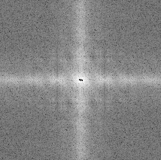
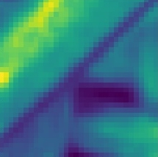
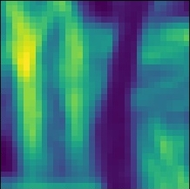
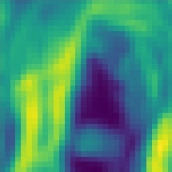
Class: Hole Class: Metal Contamination Class: Thread

Slide 12
Conclusion
Class (holes):
Sudden drop in the frequency of the pixel present.
Class (metal contamination):
Very sharp peak formed.
Class (thread):
Lots of pepper noise present.
Class (good):
Does not have much defect as the number of white and black pixels occur simultaneously without any abrupt changes.
Class (colour):
Continuous black and white pixels are visible in the image.
Class (cut):
Sudden change at the peak with shifting of colour range.

Slide 13
Implementation : Morphology

Slide 14
Morphology
Morphology is a broad set of image processing operations that process images based on shapes. Morphological operations apply a structuring element to an input image, creating an output image of the same size.

Slide 15
Types of Morphological Operations
1)Dilation
Morphological dilation makes objects more visible and fills in small holes in objects. Lines appear thicker, and filled shapes appear larger.
2) Erosion
Morphological erosion removes floating pixels and thin lines so that only substantive objects remain. Remaining lines appear thinner and shapes appear smaller.
3)Open
Morphological opening is useful for removing small objects and thin lines from an image while preserving the shape and size of larger objects in the image
4) Close
Morphological closing is useful for filling small holes in an image while preserving the shape and size of large holes and objects in the image.

Slide 16
Implementation
The main approach the has been used for fabric defect detection is to perform erosion operation on the given image and the threshold the image (or convert it to binary image),after appyling these operations on the image the defects in the fabric will be clearly visible.
Here we have take 5 images from each category (good,colour,cut,holes and metallic contamination),and and performed operation on them.

Slide 17
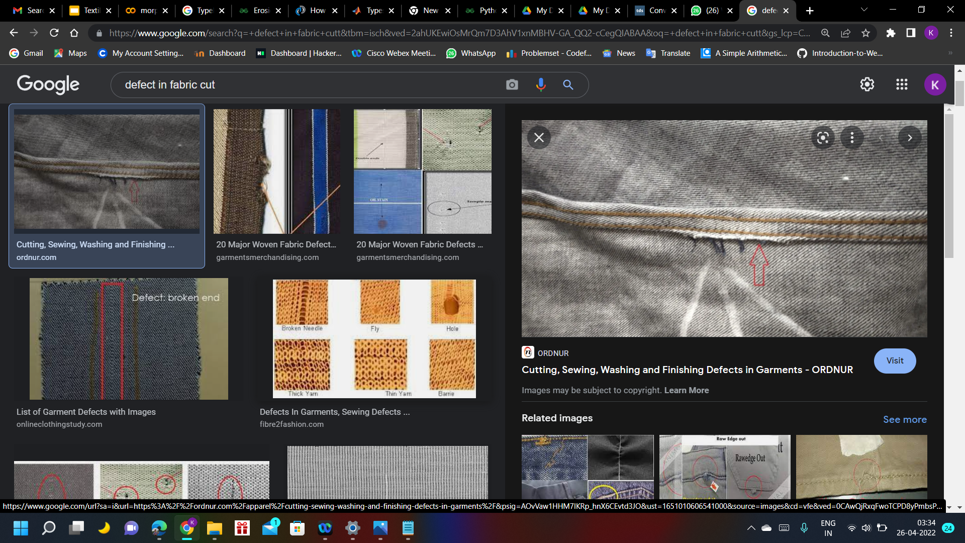
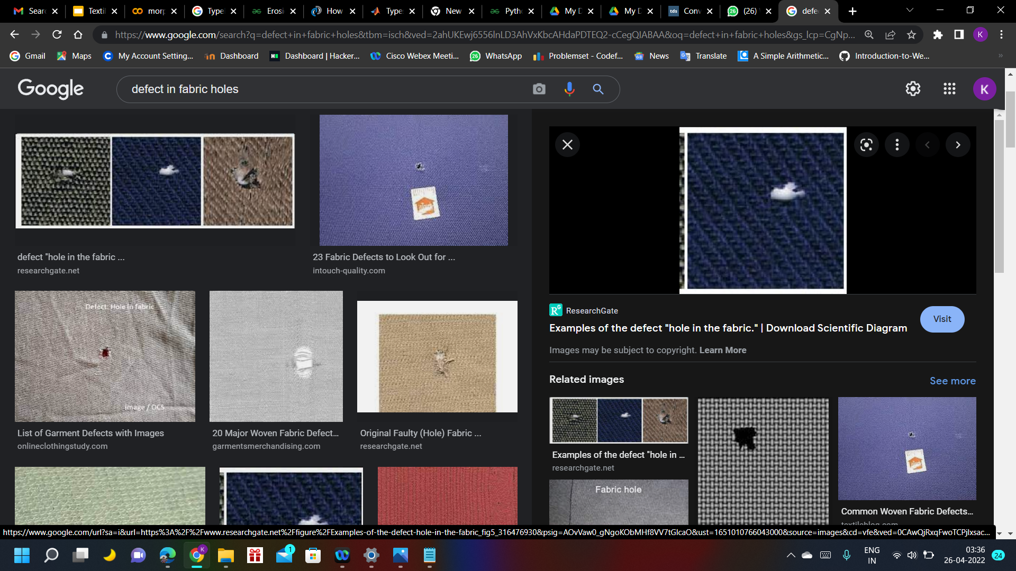
Fabric Defects
Cutting
Holes

Slide 18
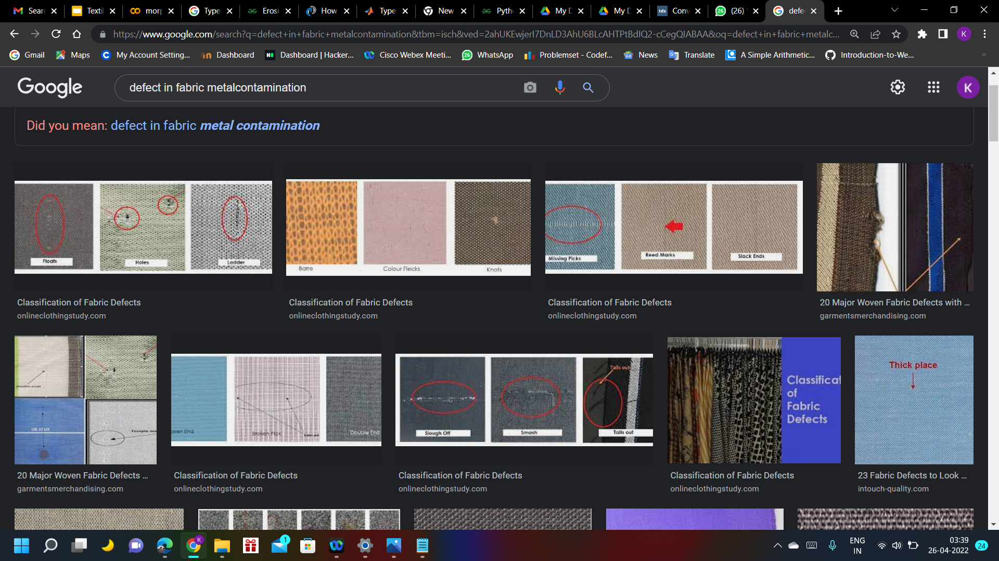
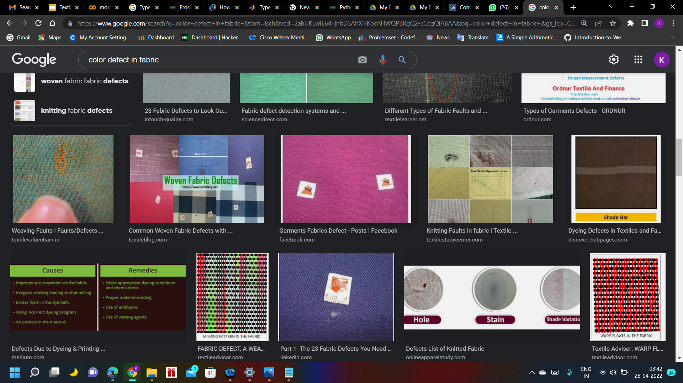
Fabric Defects
Metal contamination
colour

Slide 19
Results

Slide 20
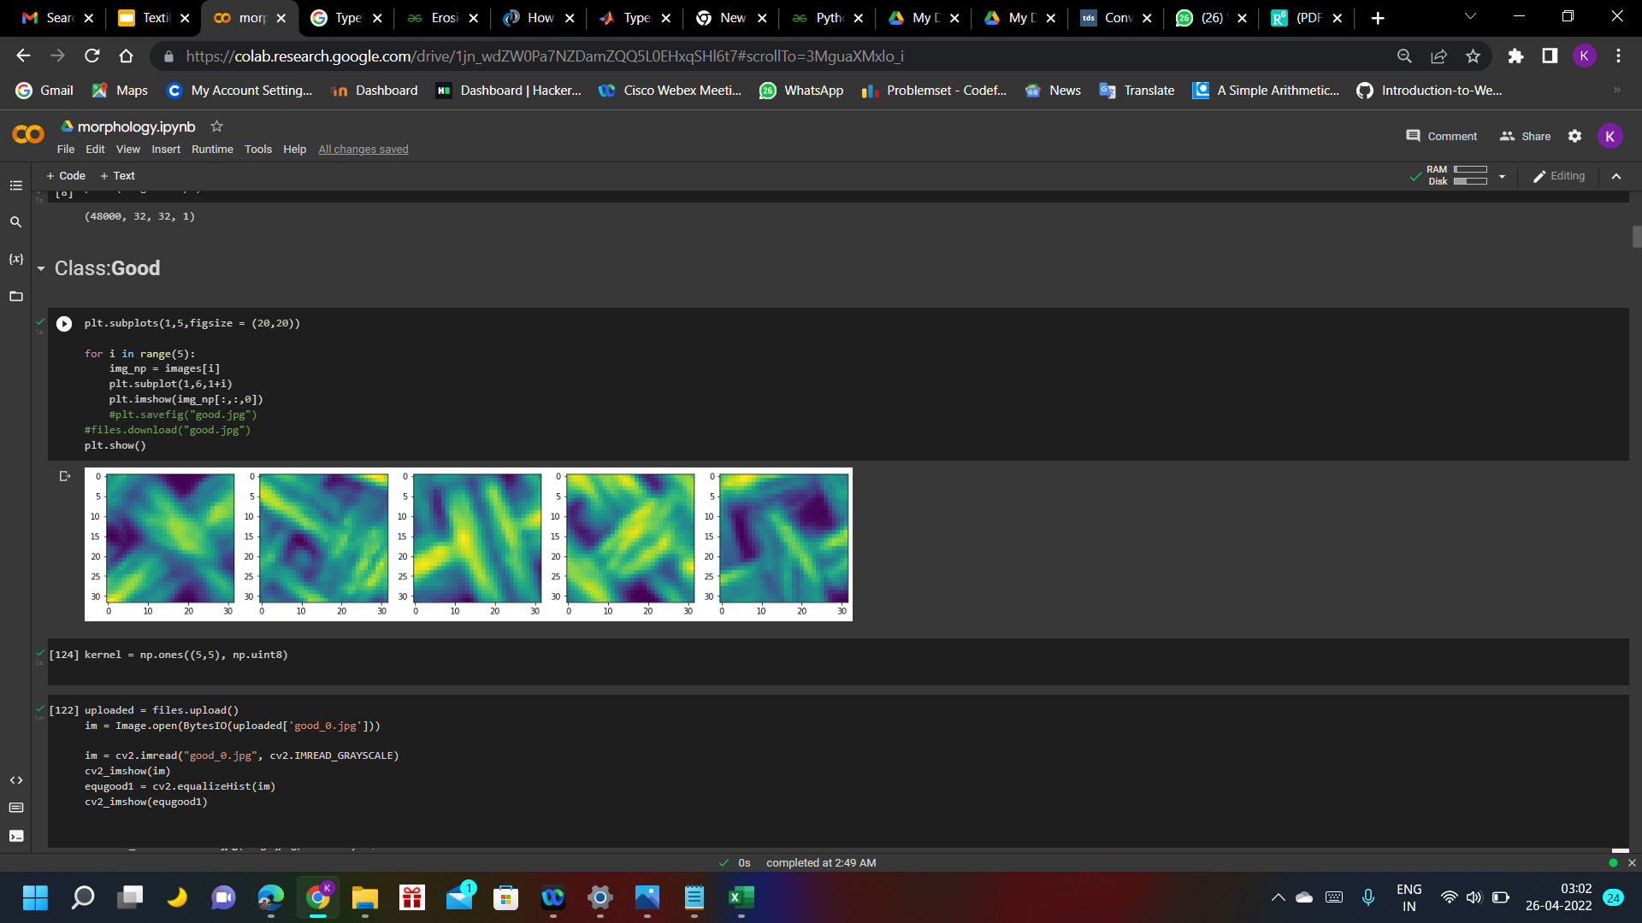

Preparing the images for morphological operations
Original Image
Histogram equilization

Slide 21
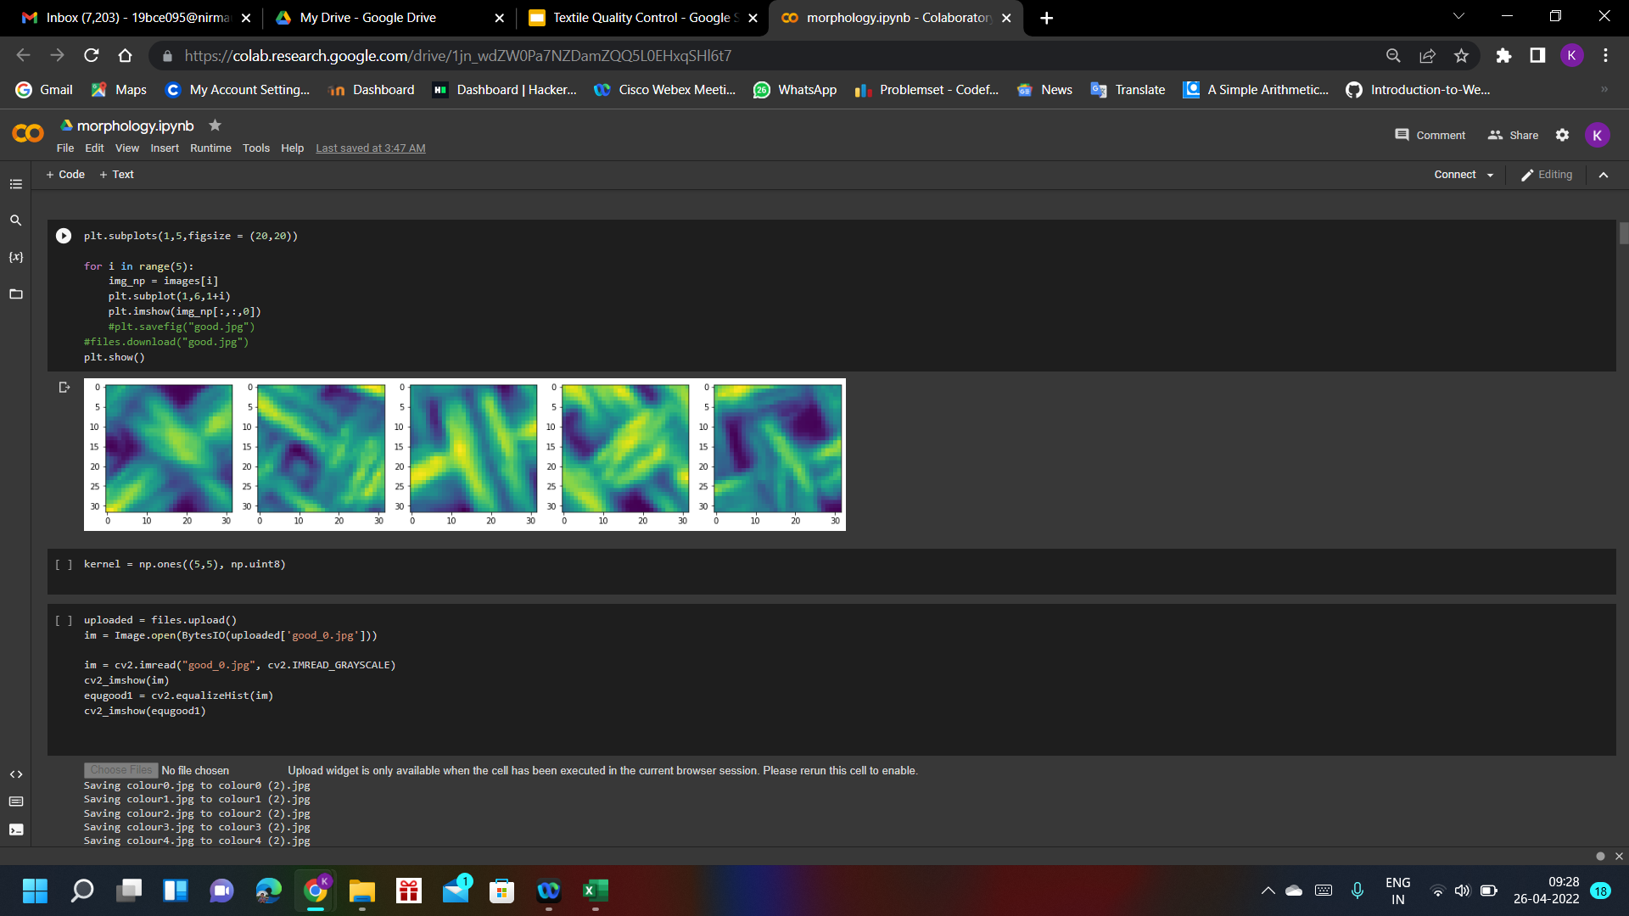

Image after applying erosion and thresholding
Original Image:
Class:good
Degree: 40

Slide 22
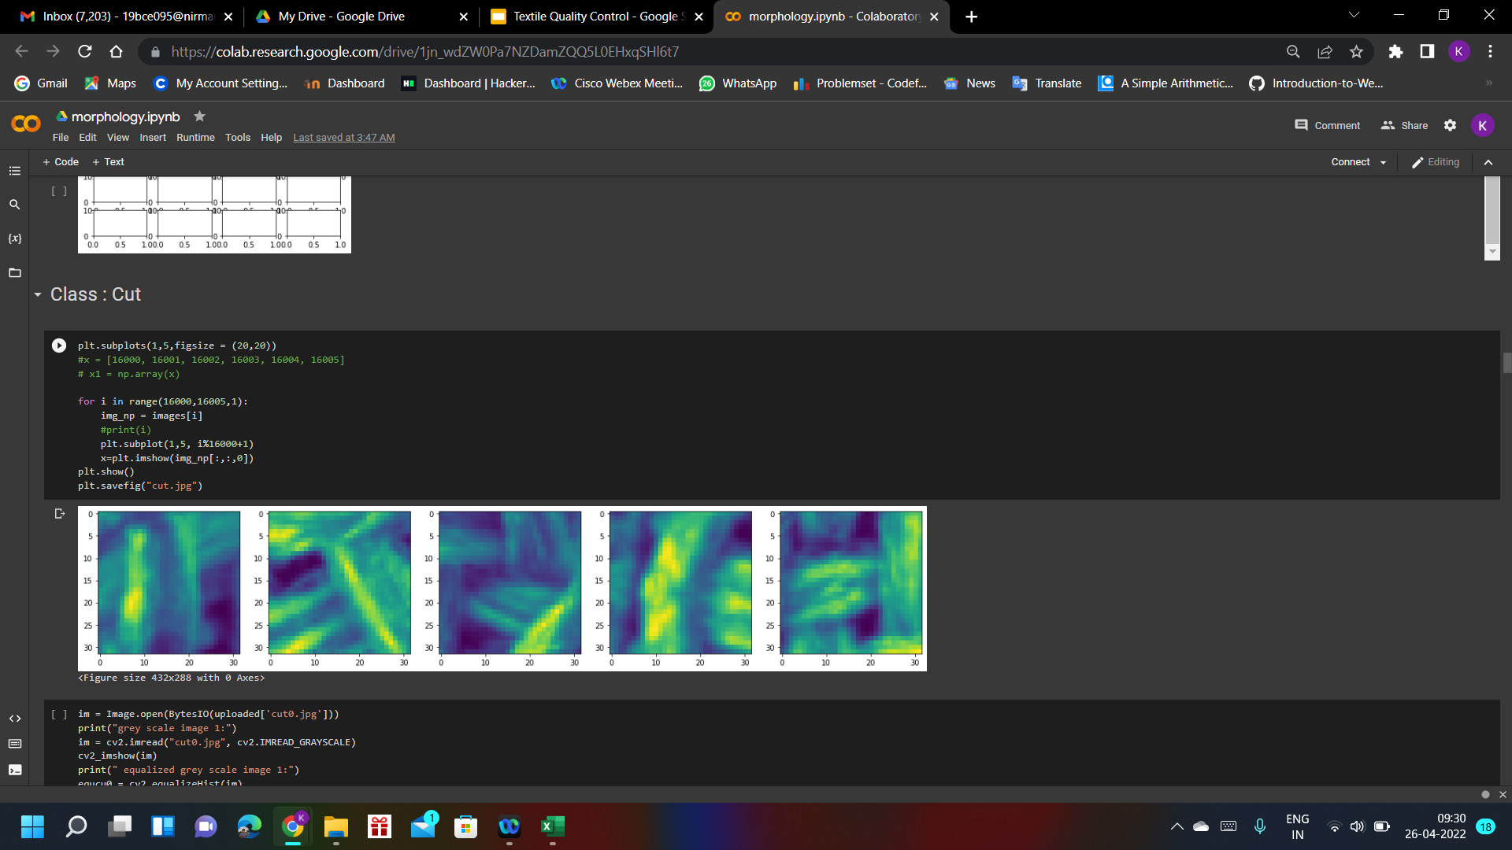

Image after applying erosion and thresholding
Original Image:
Class:cut
Degree:100

Slide 23
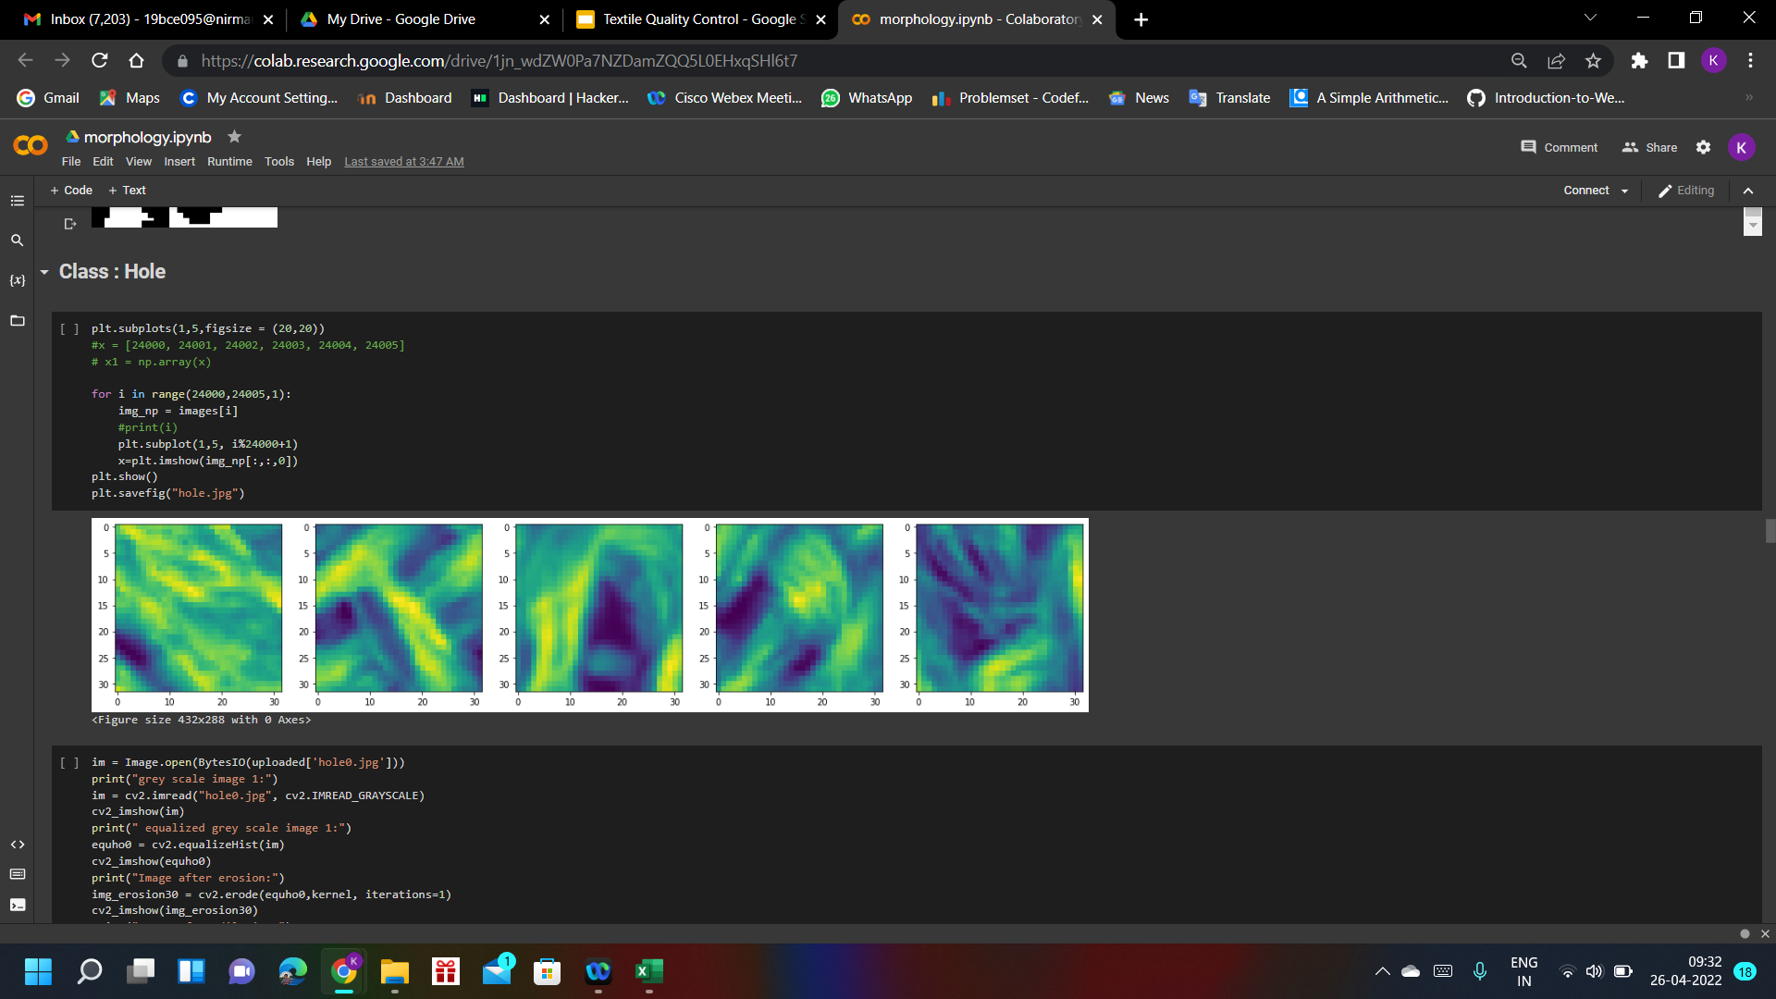
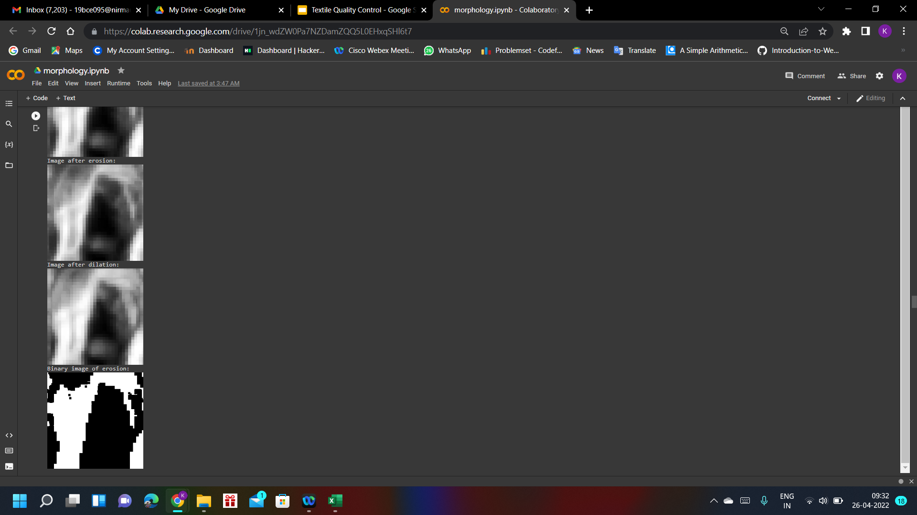
Image after applying erosion and thresholding
Original Image:
Class:Holes
Degree:80

Slide 24
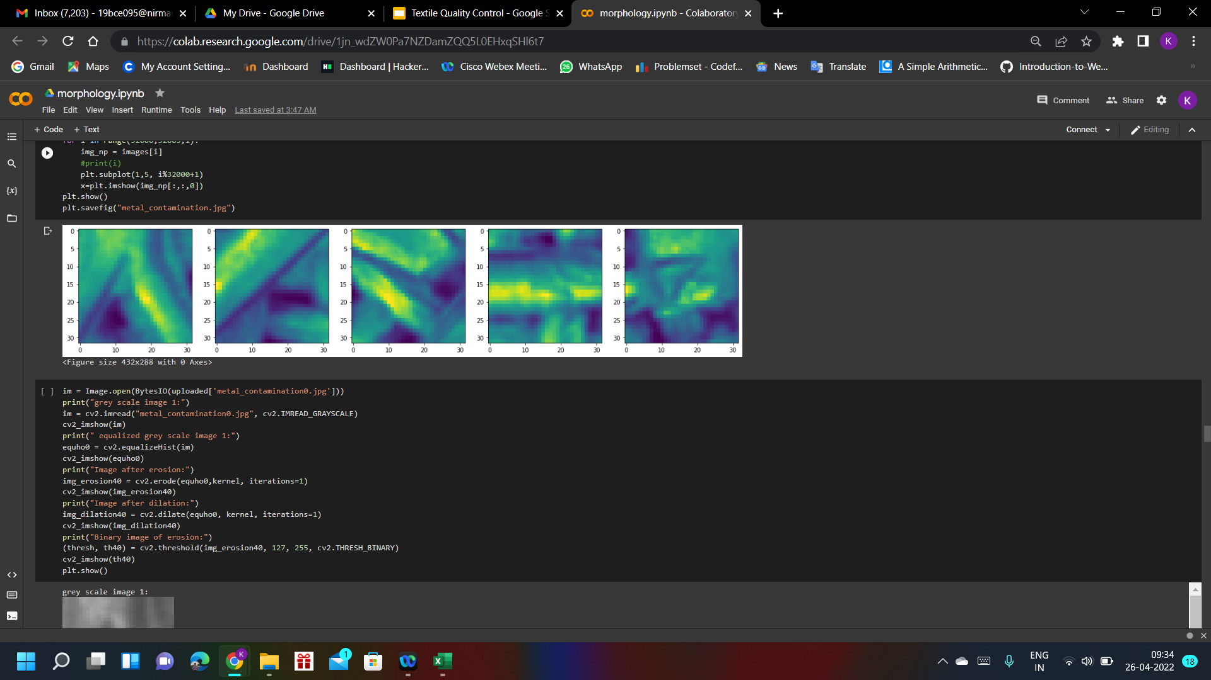

Image after applying erosion and thresholding
Original Image:
Class:Metal contamination
Degree:80

Slide 25
Conclusion
class (good):
does not have much defect as the number of whiteand black pixels occur simultaneously.
class(cut):
Clearly lines of black and while pixels visible in the image.
class(holes):
The image contains holes (formed by pixel value 0).
class(metal contamination):
Continuous black and white pixels are visible in the image.

Slide 26
https://www.bingol.edu.tr/documents/Review(1).pdf
https://sciendo.com/pdf/10.2478/aut-2019-0035
https://medcraveonline.com/JTEFT/fabric-defect-detection-using-fourier-transform-and-gabor-filters.html
https://www.researchgate.net/publication/221905536_Detection_of_Defects_in_Fabric_by_Morphological_Image_Processing
https://hub.hku.hk/bitstream/10722/42882/1/61147.pdf?accept=1
References

